Slide 1
Summary – Algorithm ToolBox

Slide 2
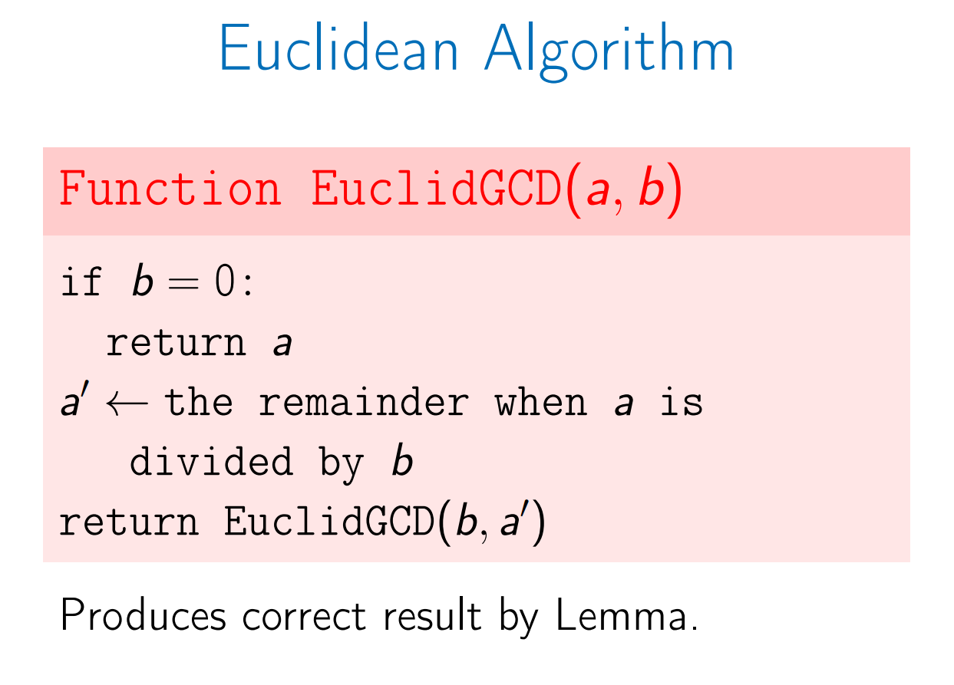
Each step reduces the size of numbers by about a factor of 2.
Takes about log(ab) steps.

Slide 3
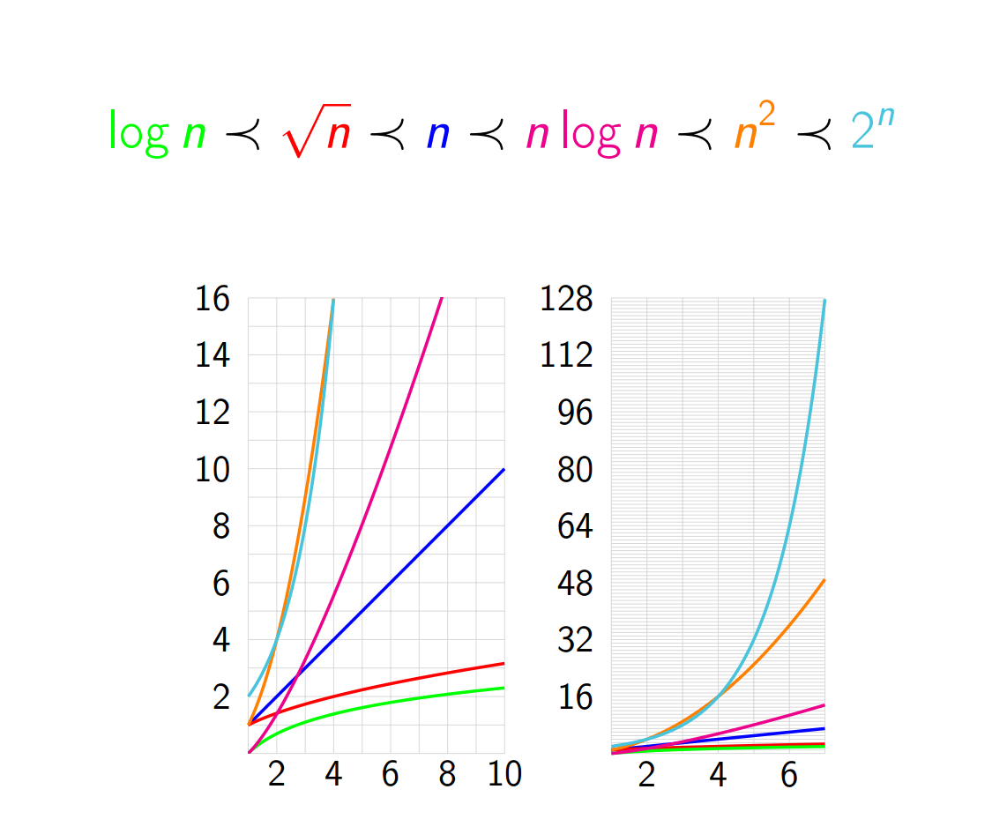
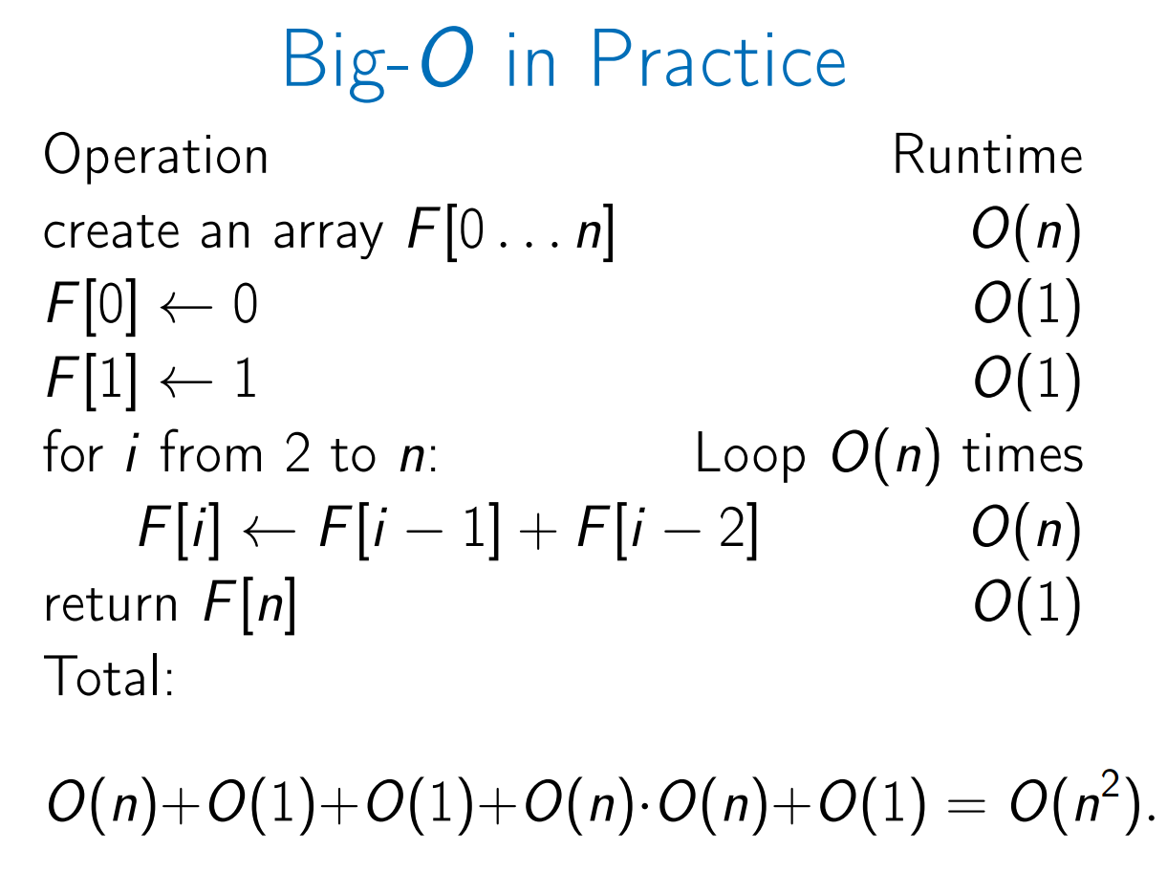

Slide 4
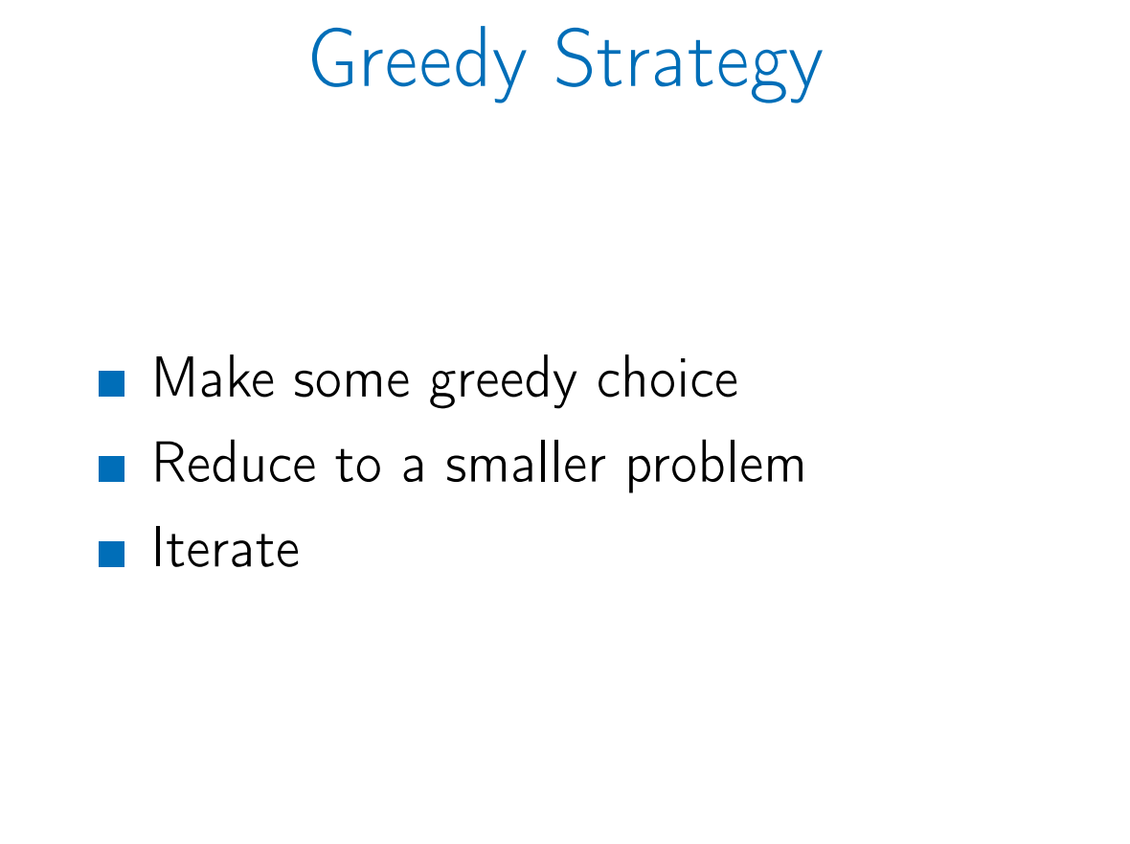
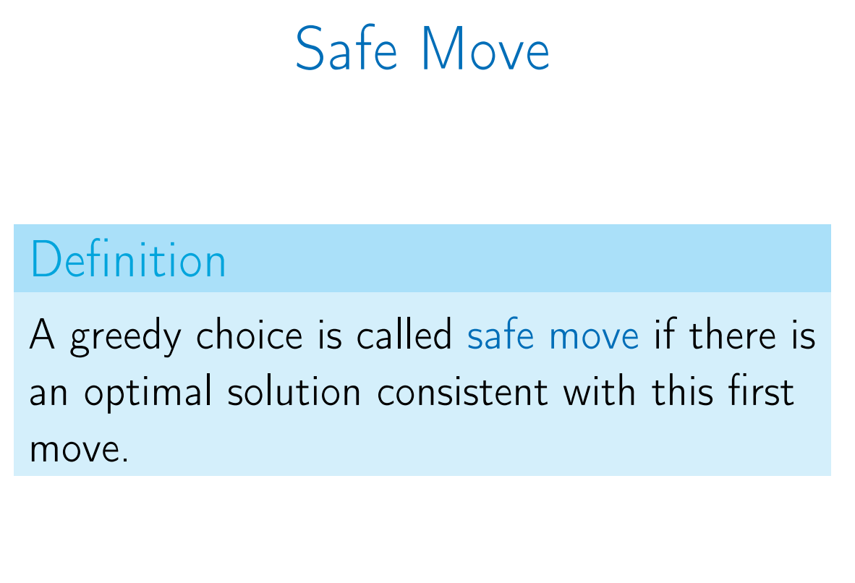

Slide 5
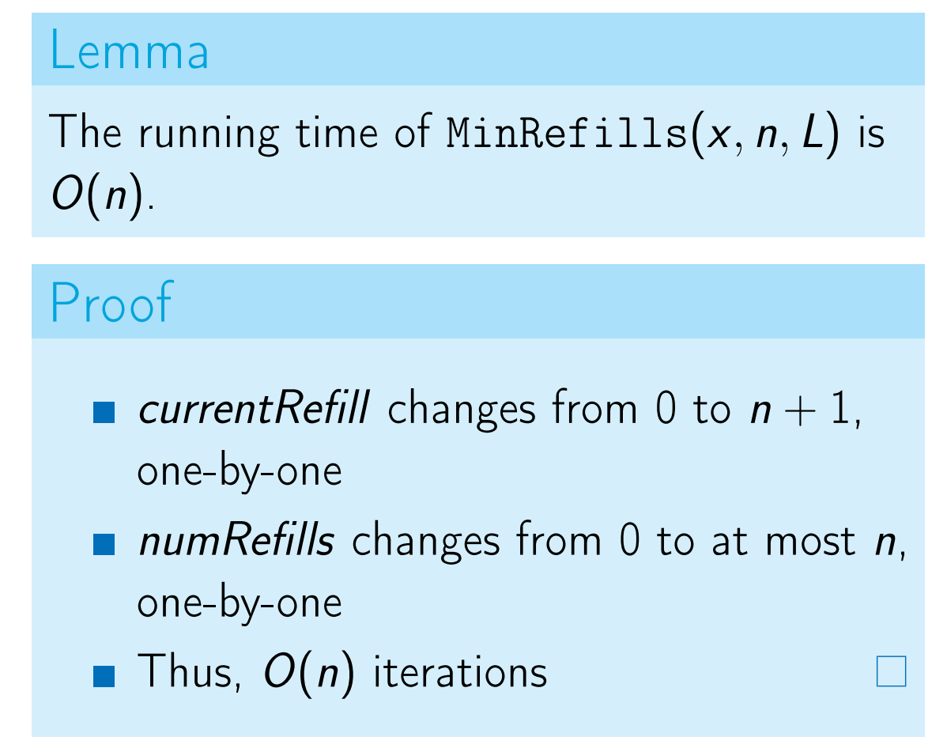
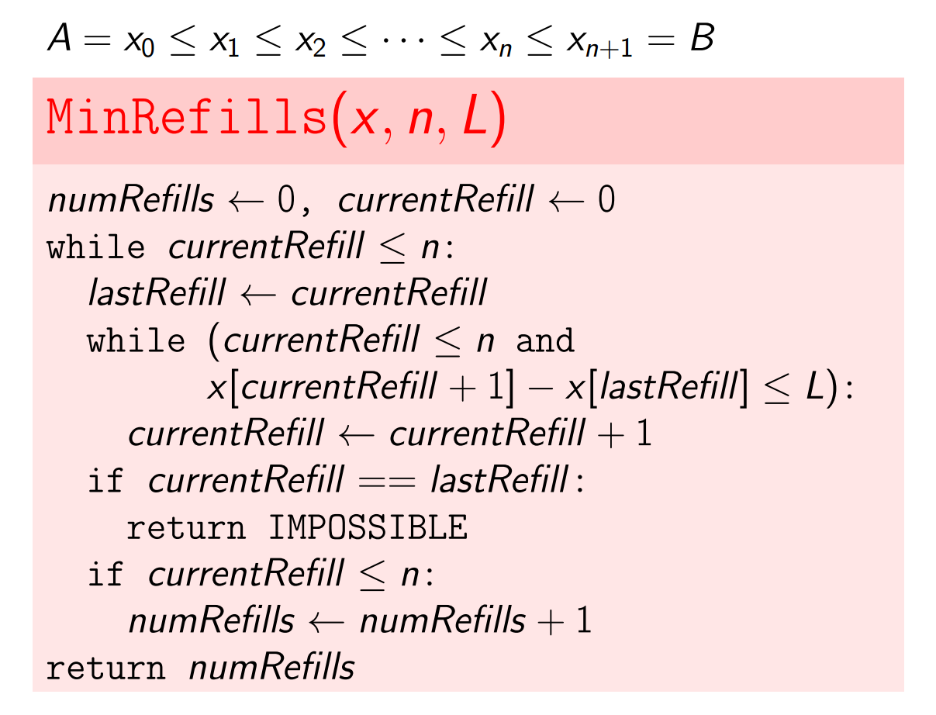
Car Fueling Problem

Slide 6
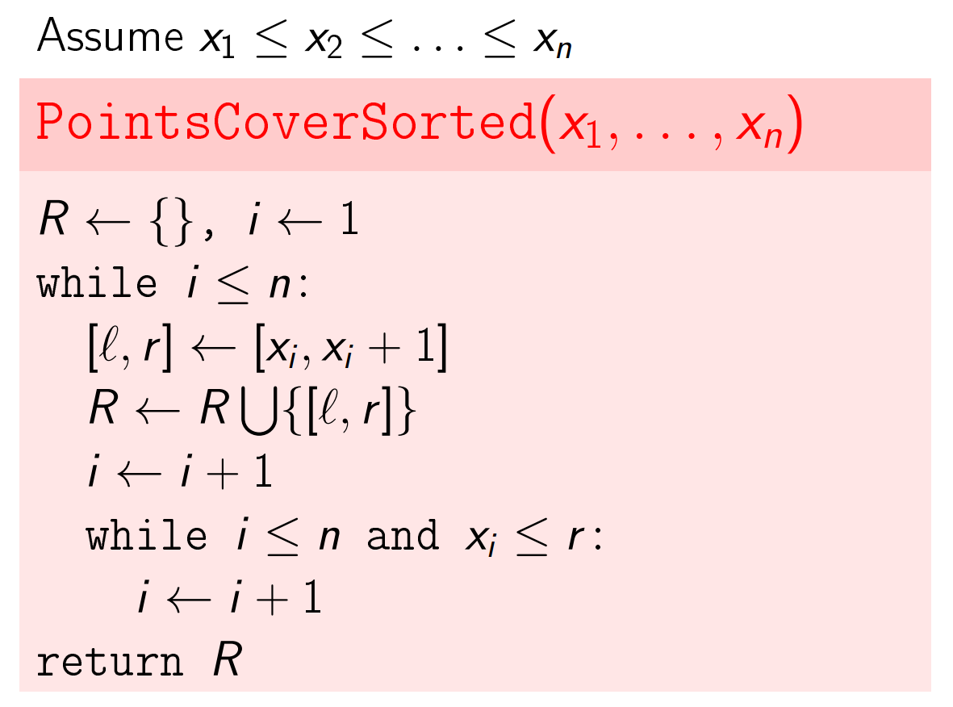
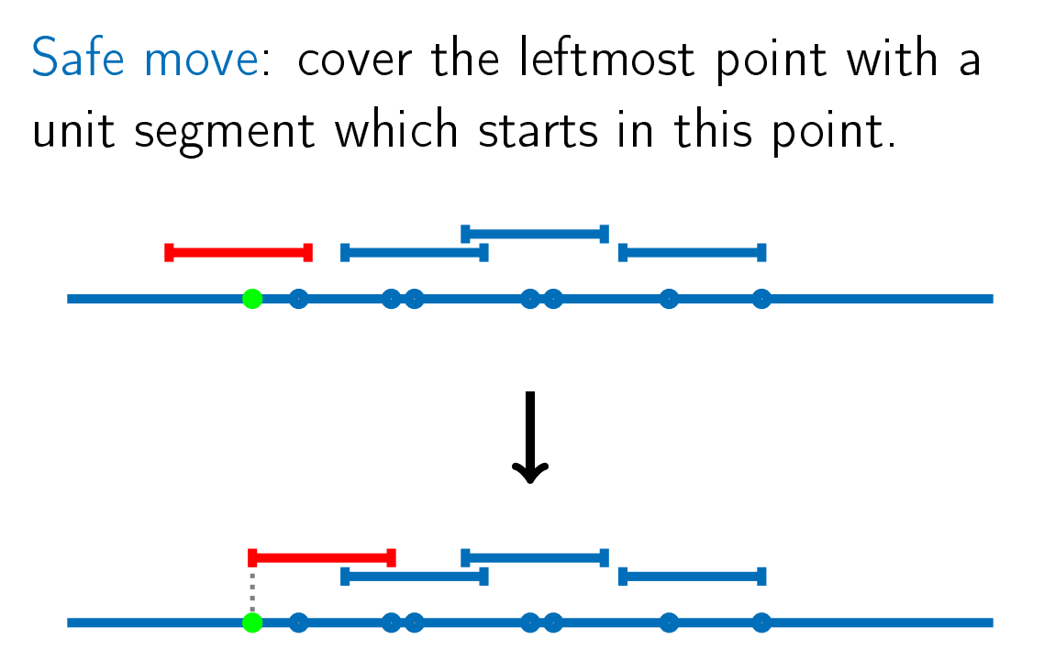
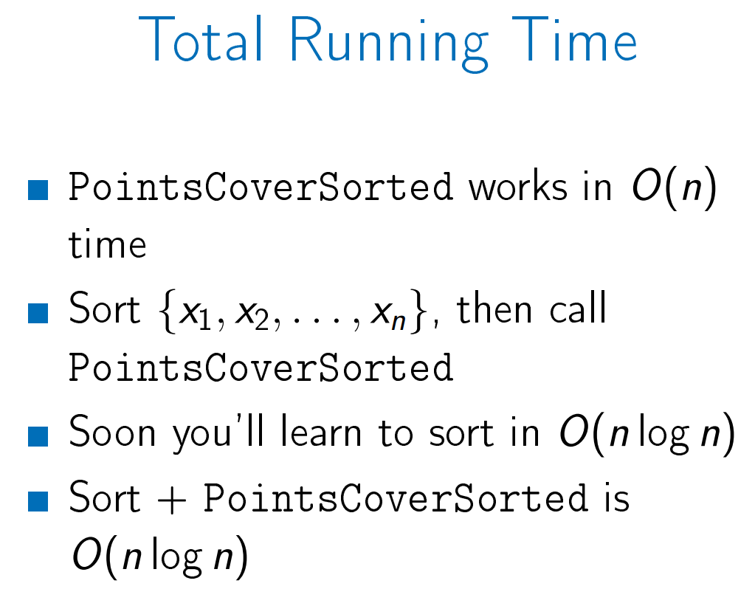
Grouping Children

Slide 7
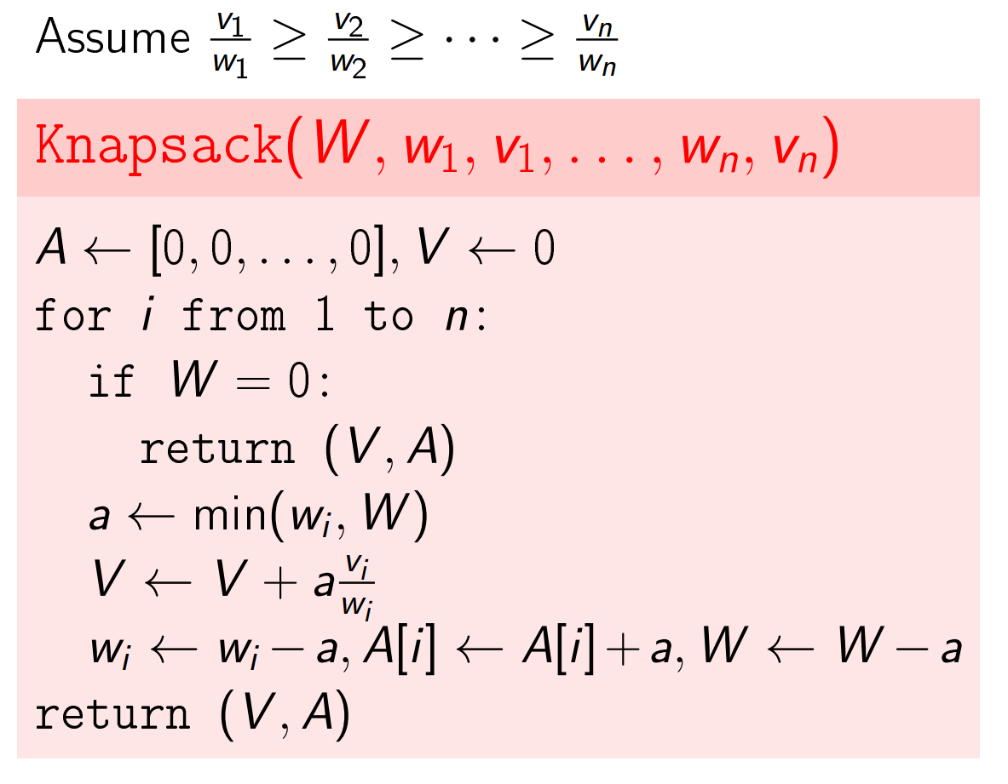
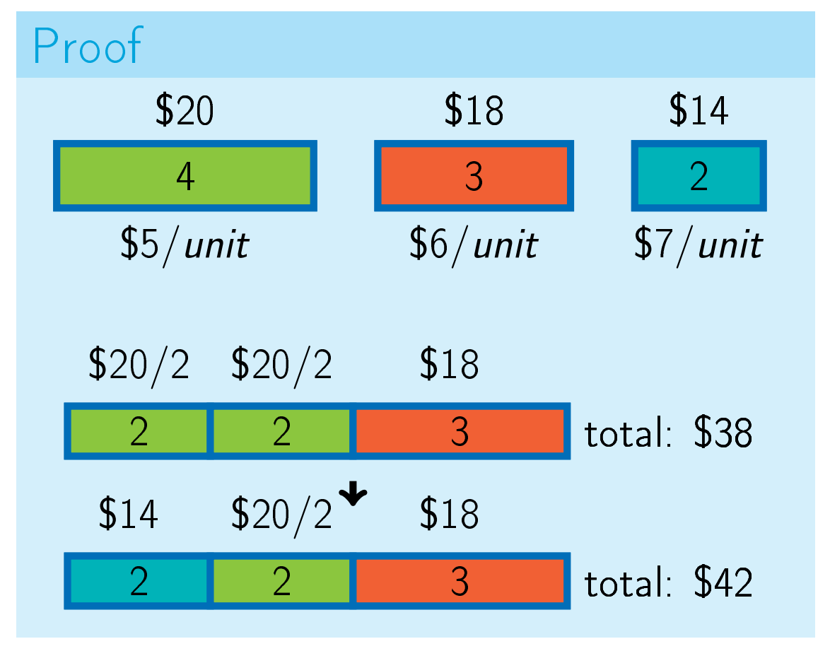
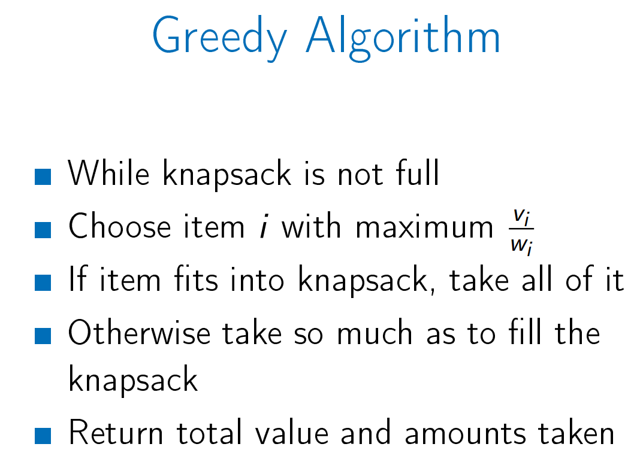
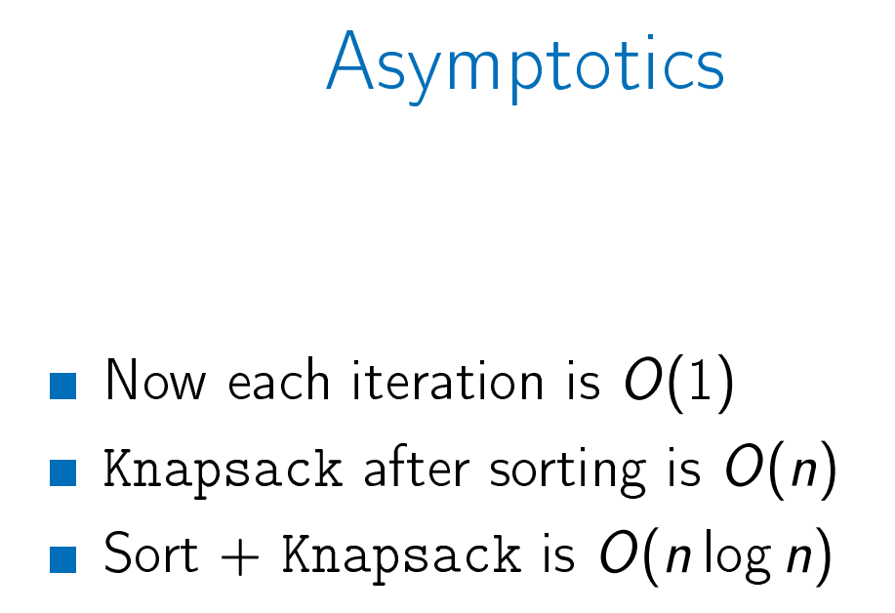
Fractional Knapsack

Slide 8
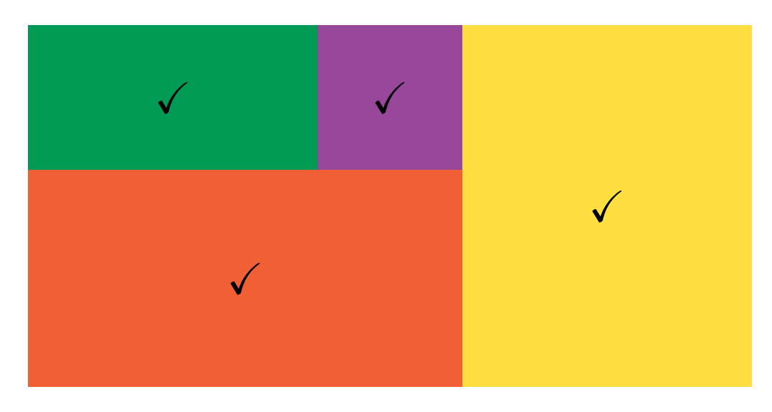
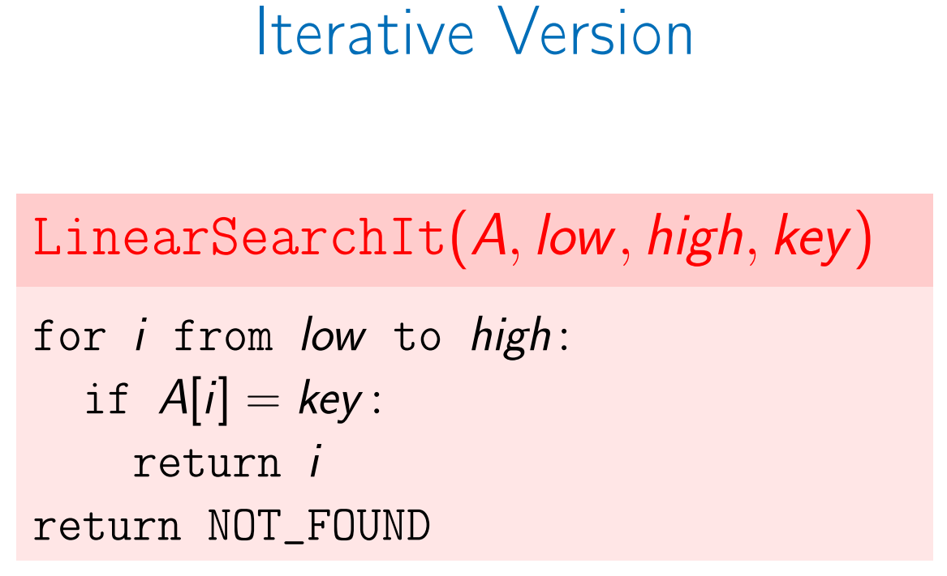
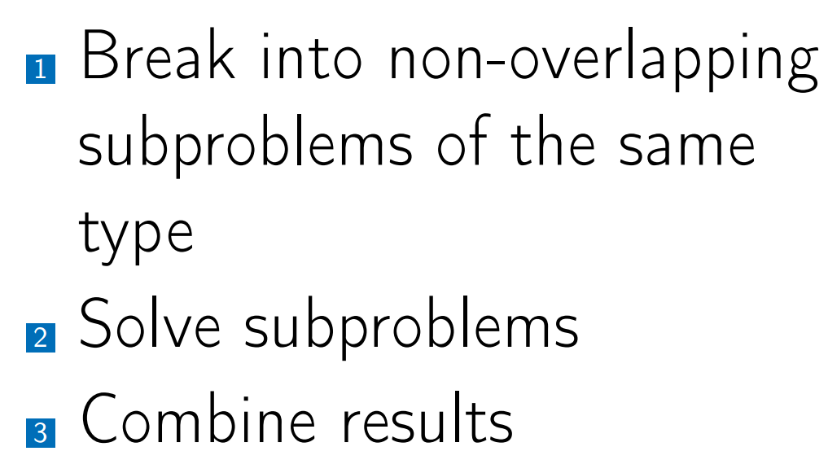
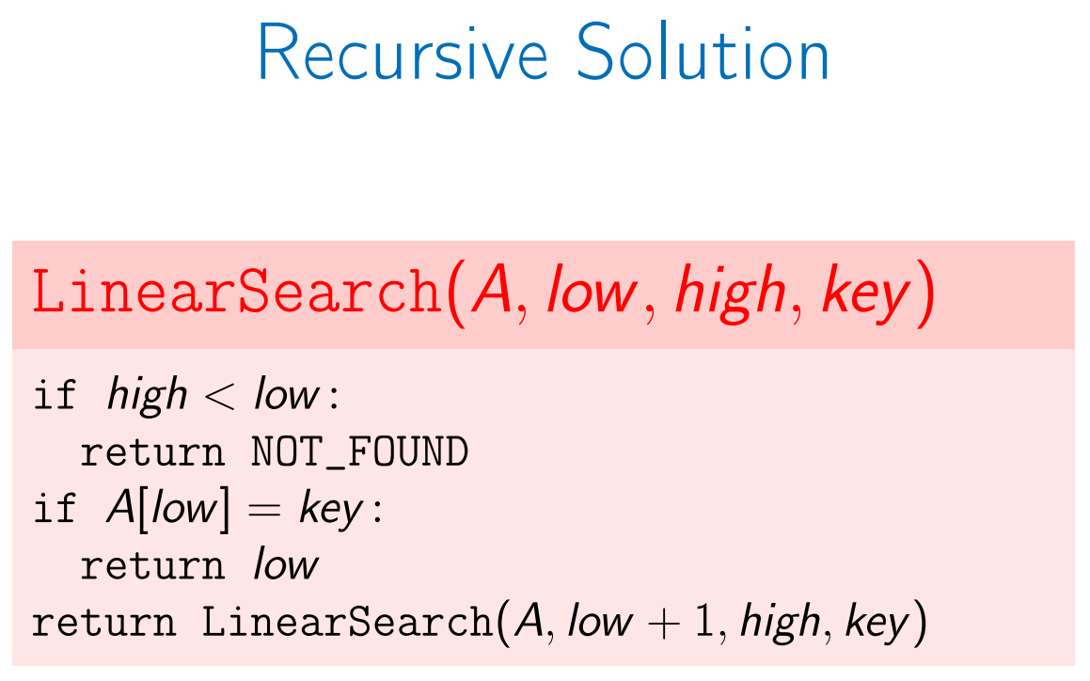
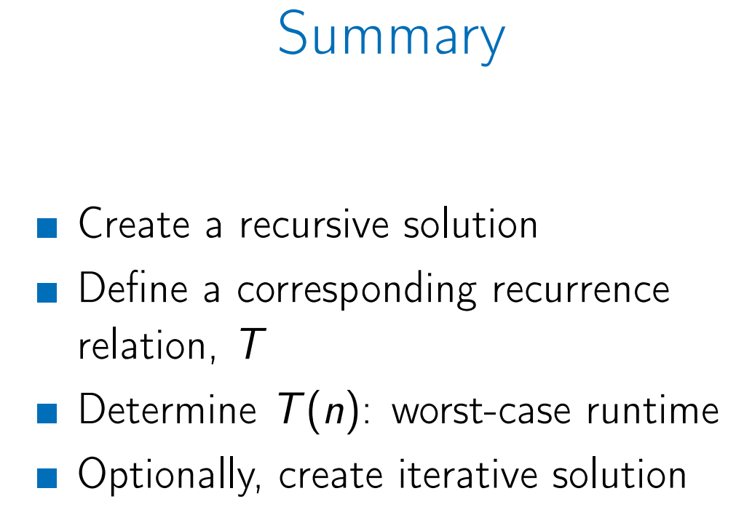
Linear Search (Divide and Conquer)

Slide 9
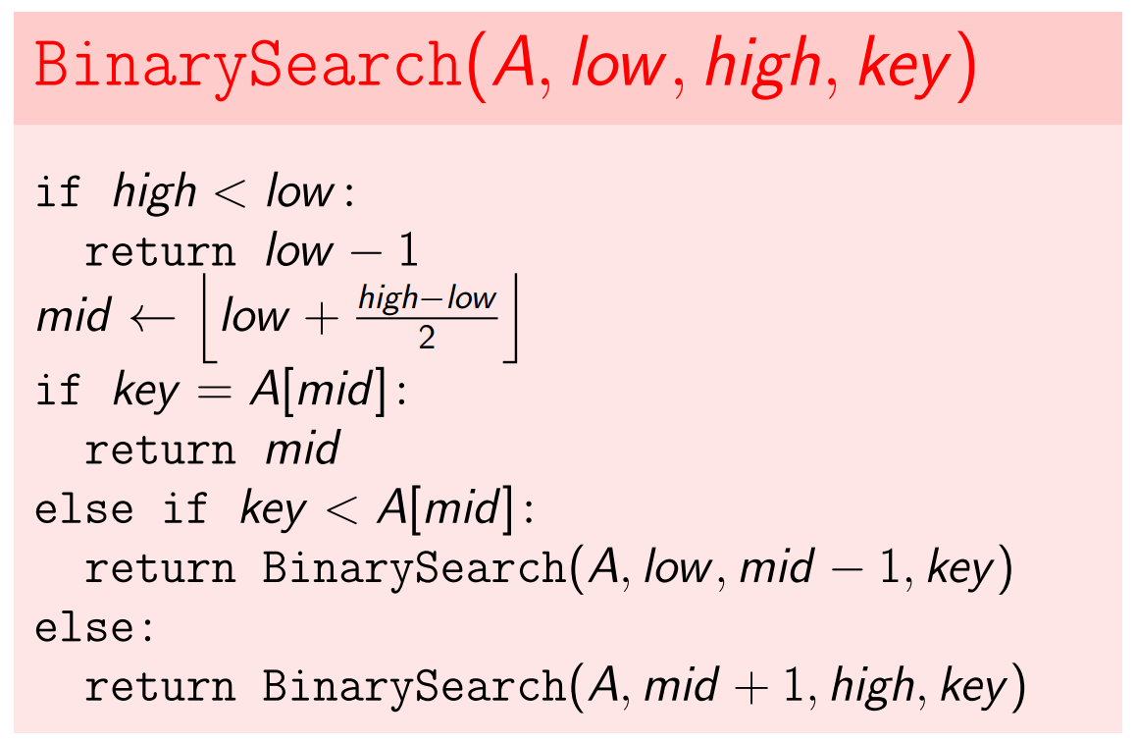
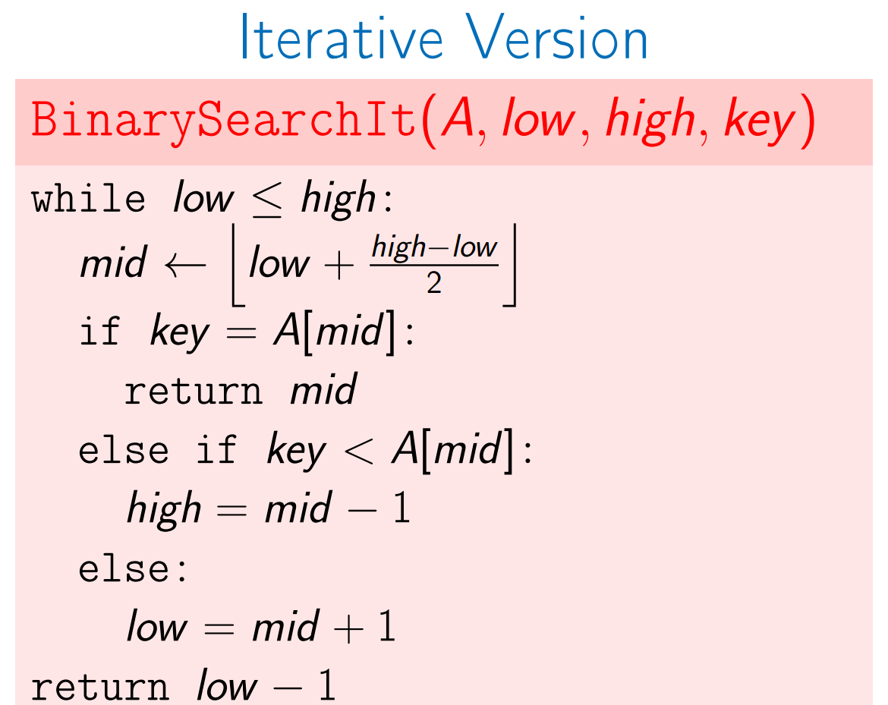
Binary Search
Running time is O(log2n).
Note that that the list is already sorted.

Slide 10
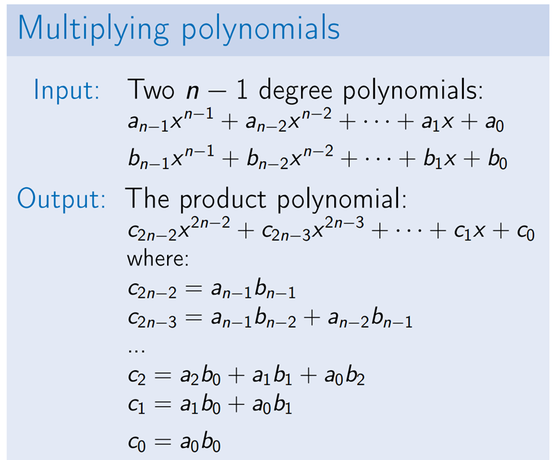
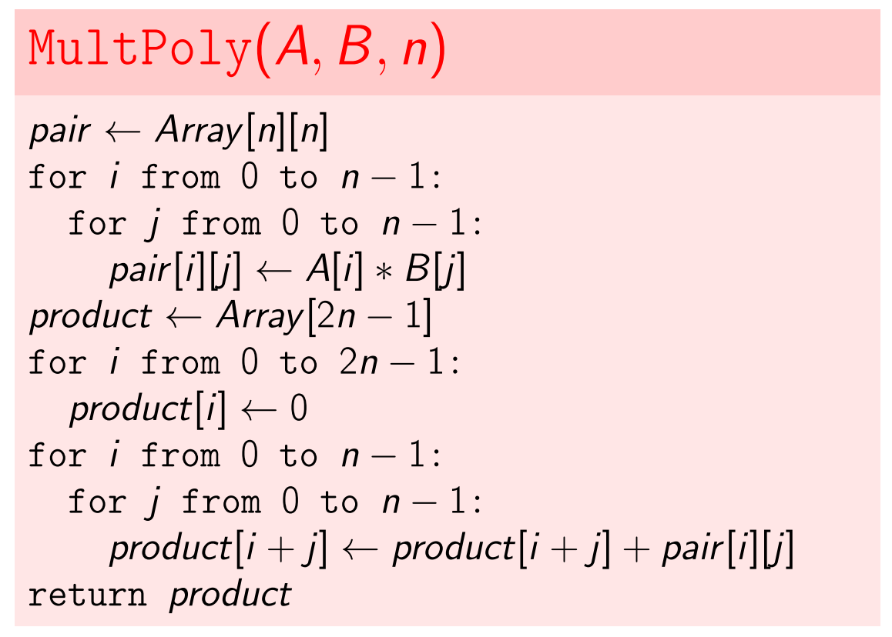
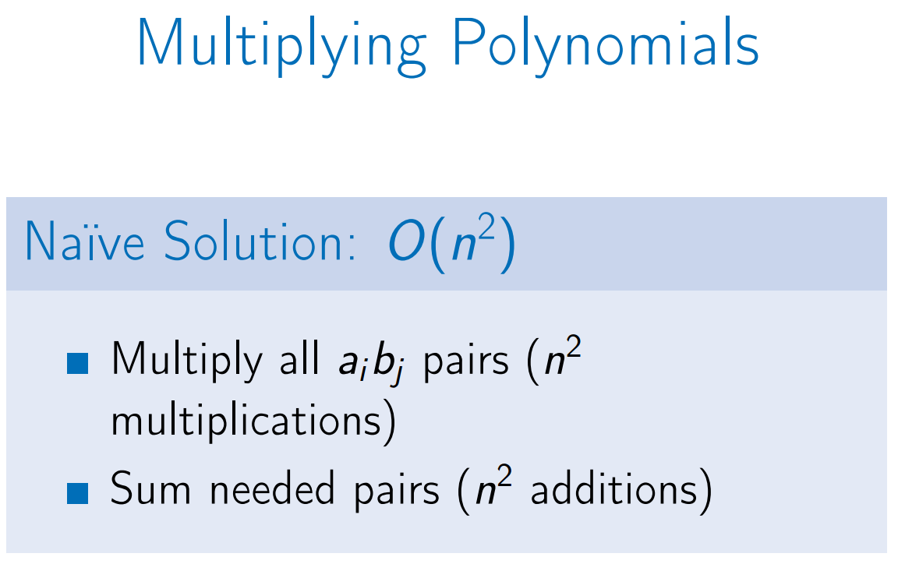
Naïve Poly Multiplication

Slide 11
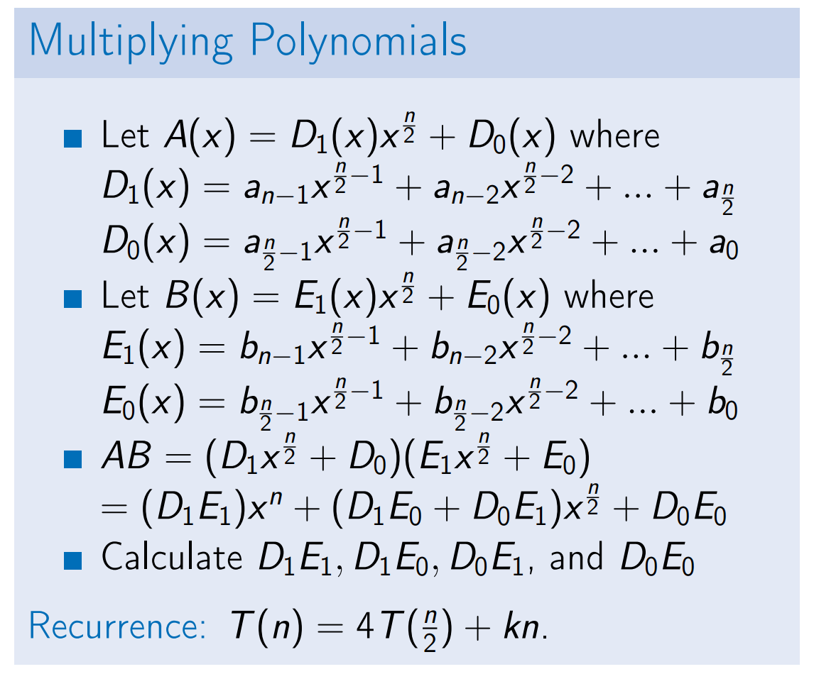
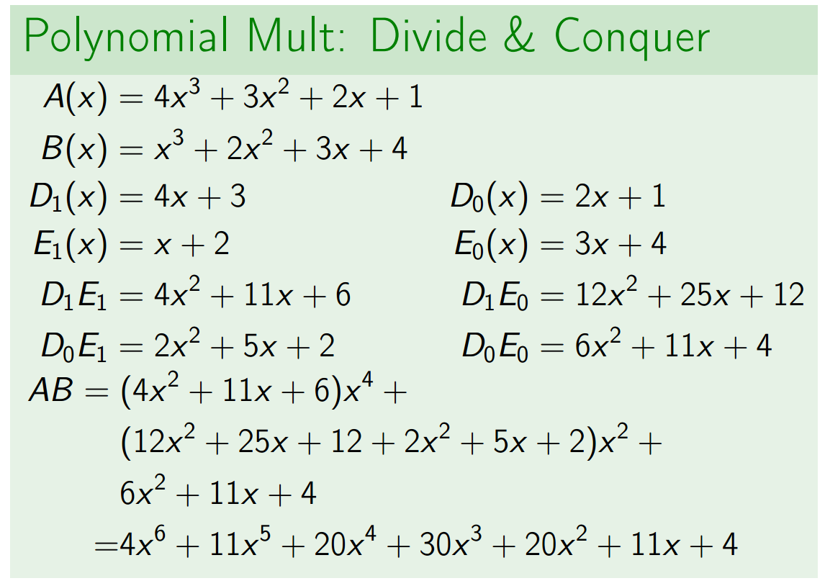
Naïve Divide and Conquer Poly Multiplication
Running time is O(n^2)

Slide 12
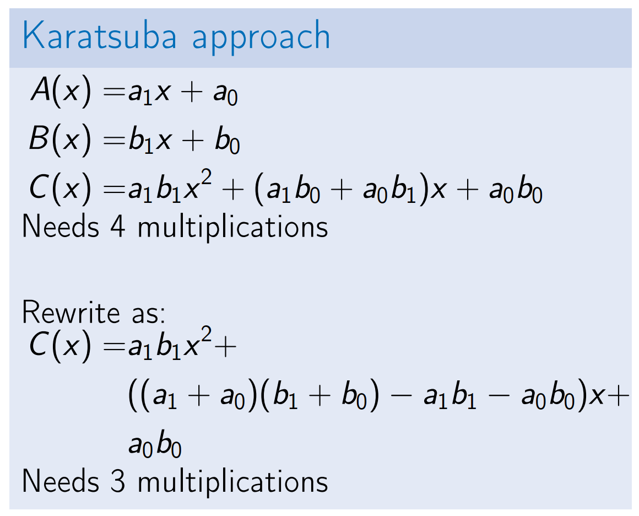
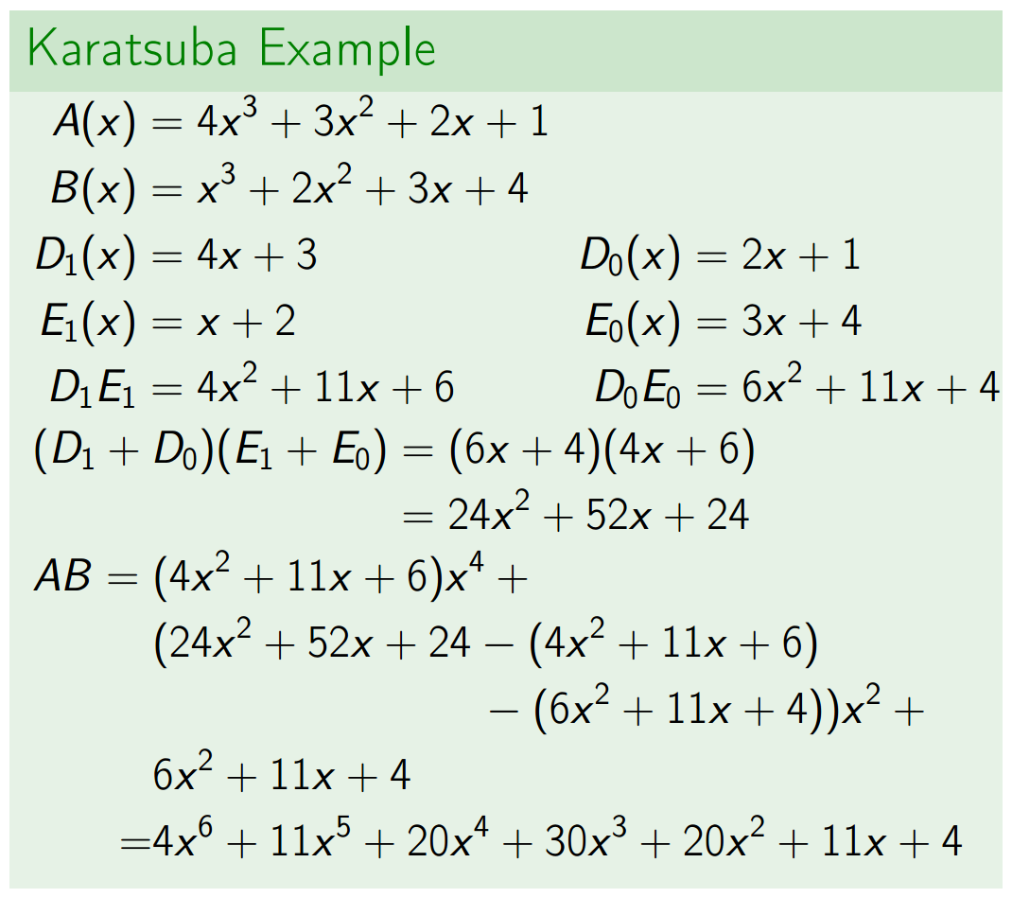
Karatsuba Approach to Poly Multiplication
Running time is O(n^1.58)

Slide 13
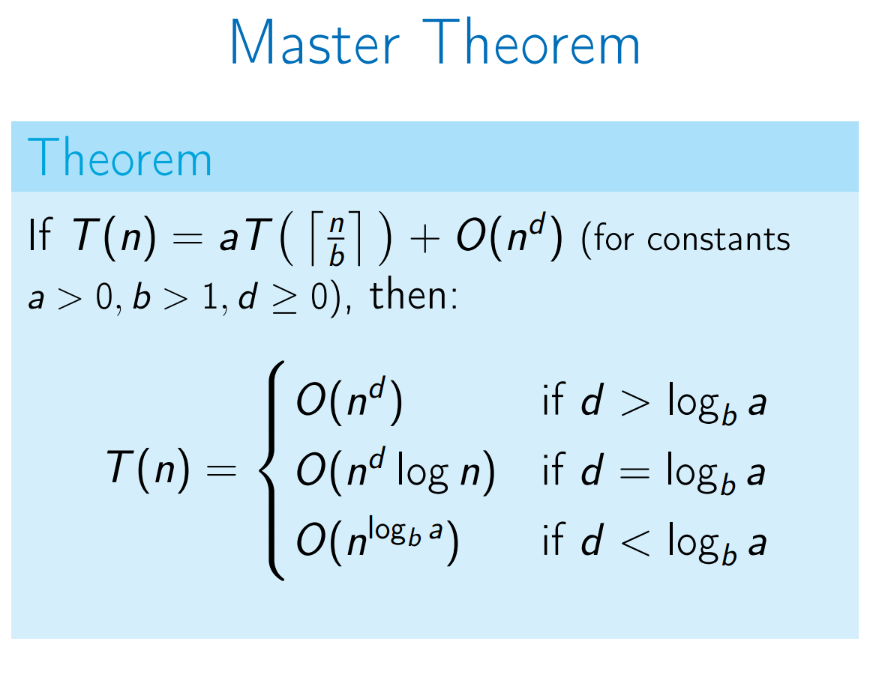
Master Theorem

Slide 14
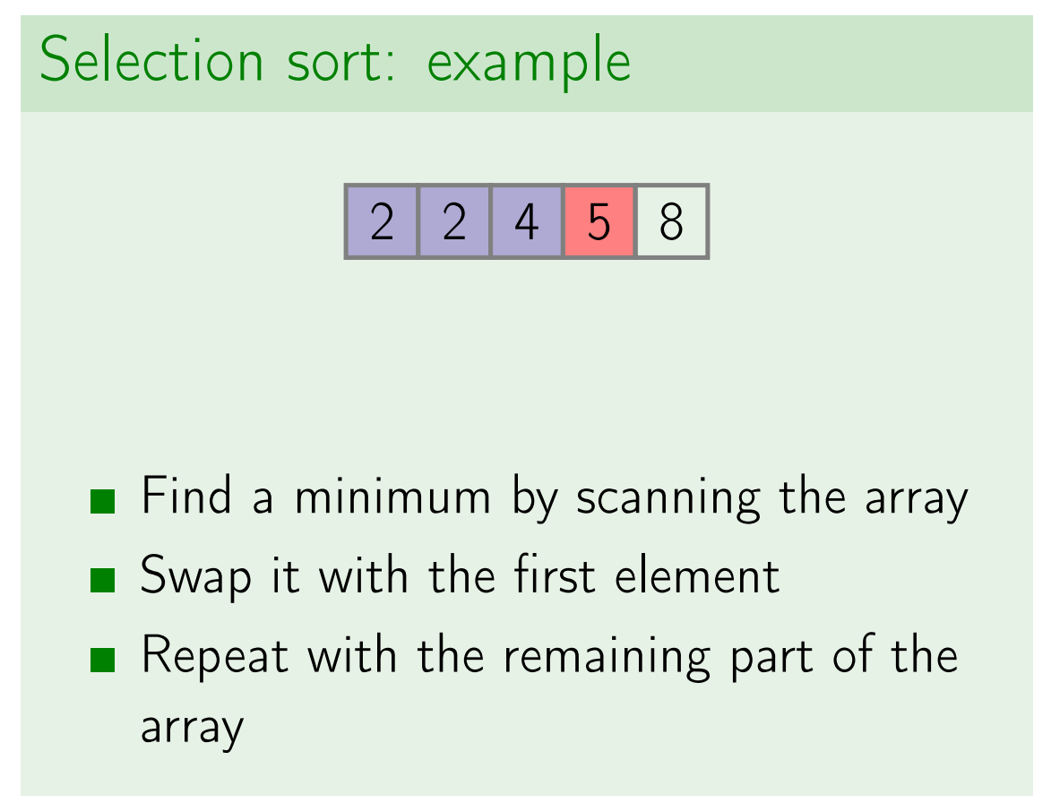
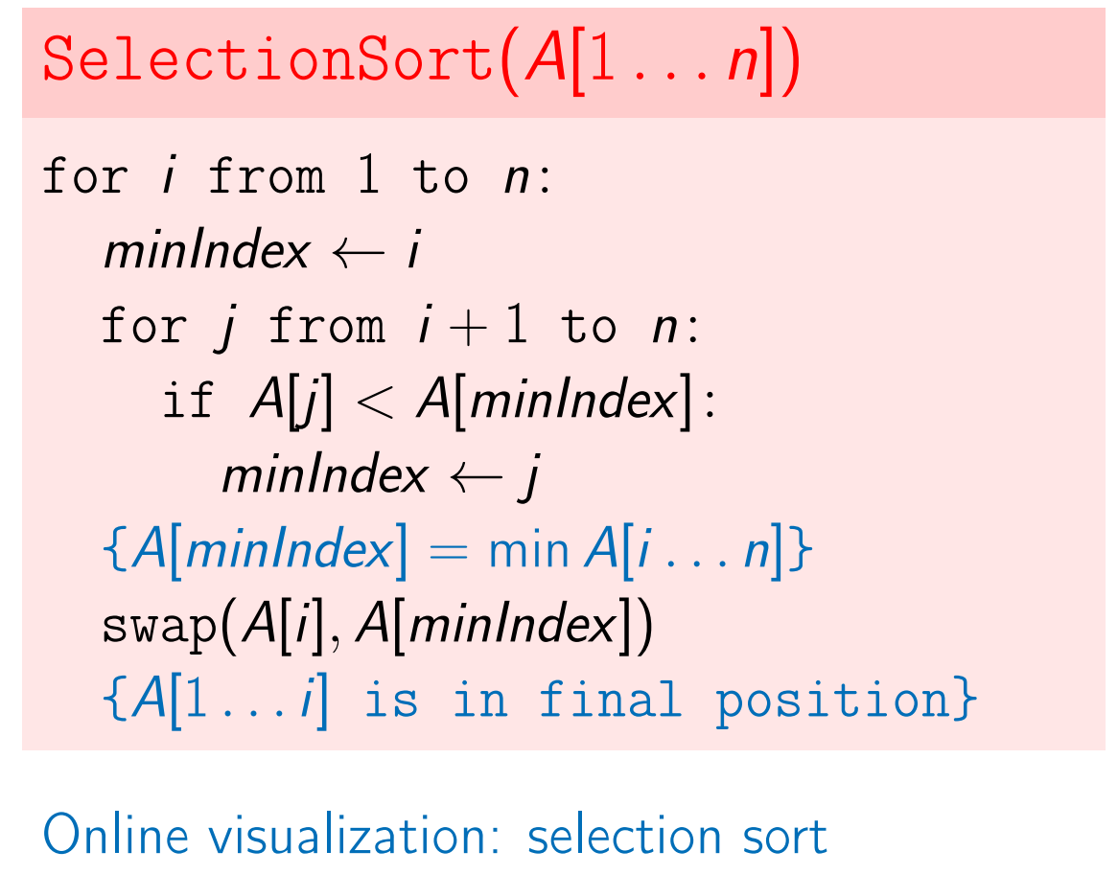
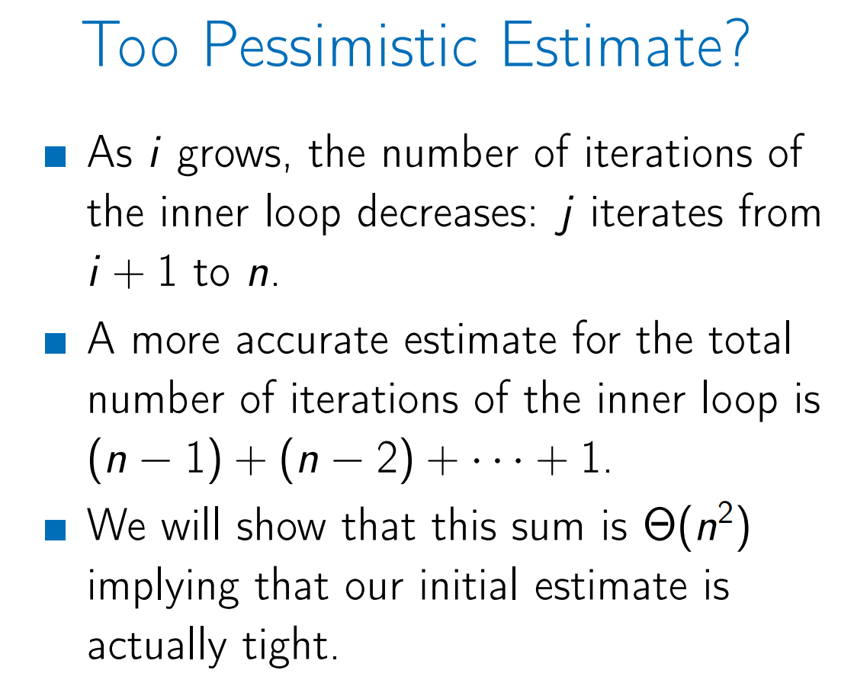
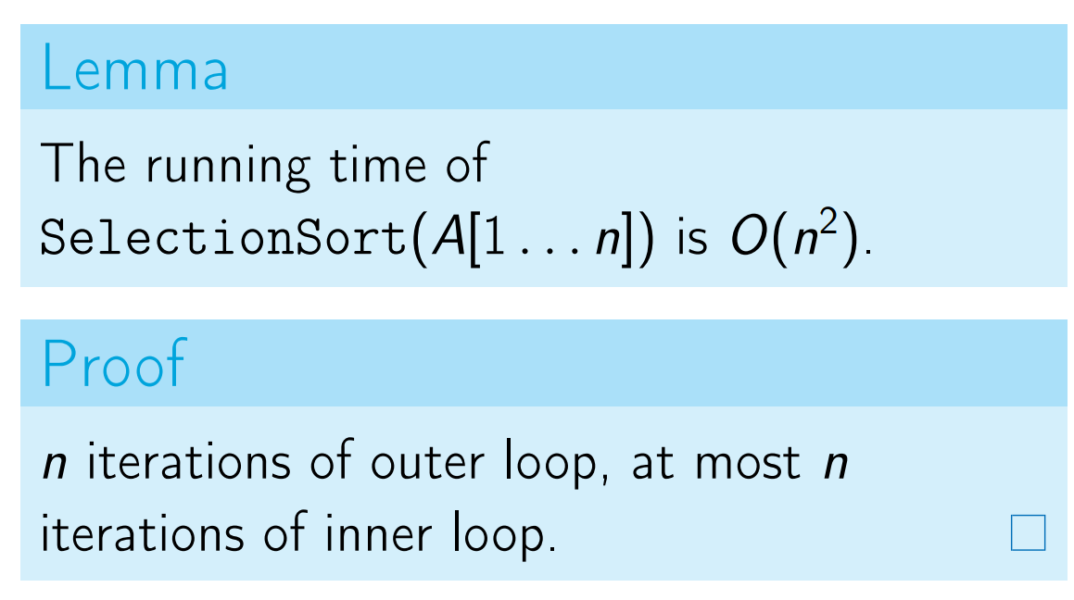
Selection Sort

Slide 15
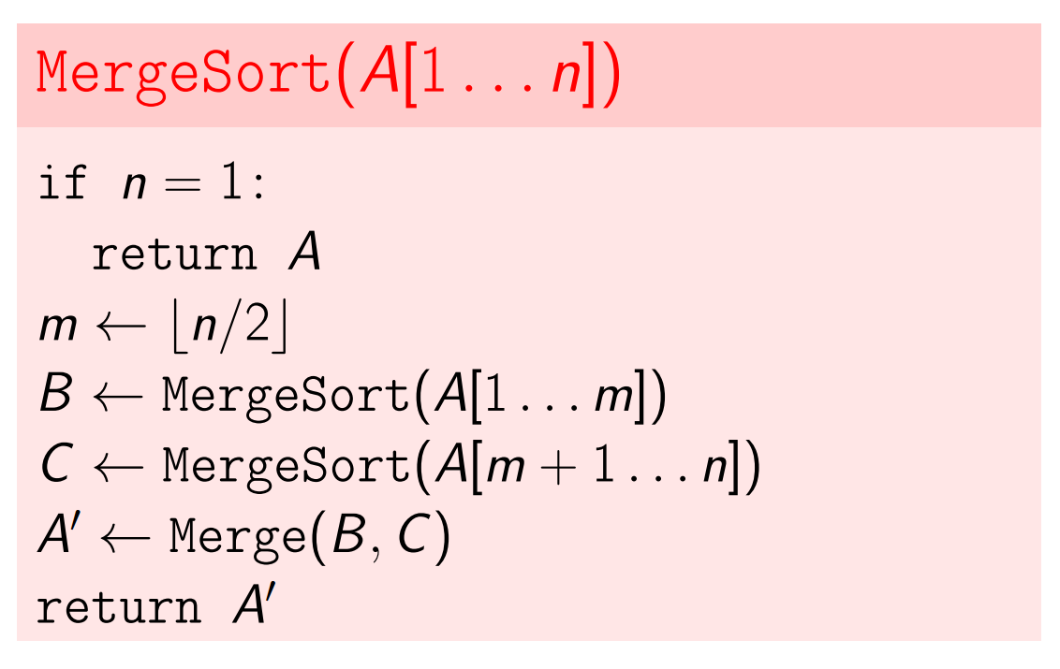
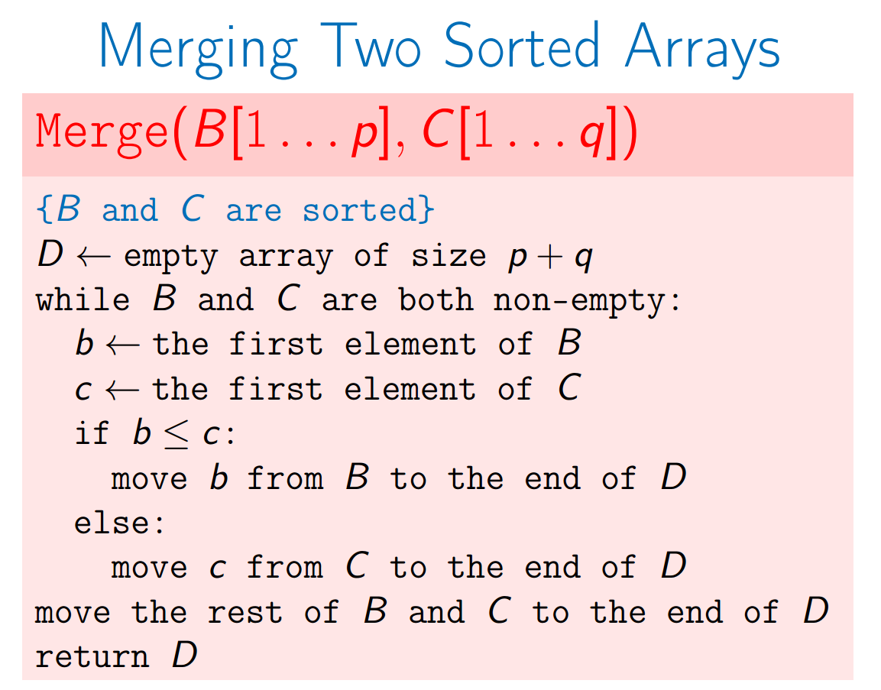
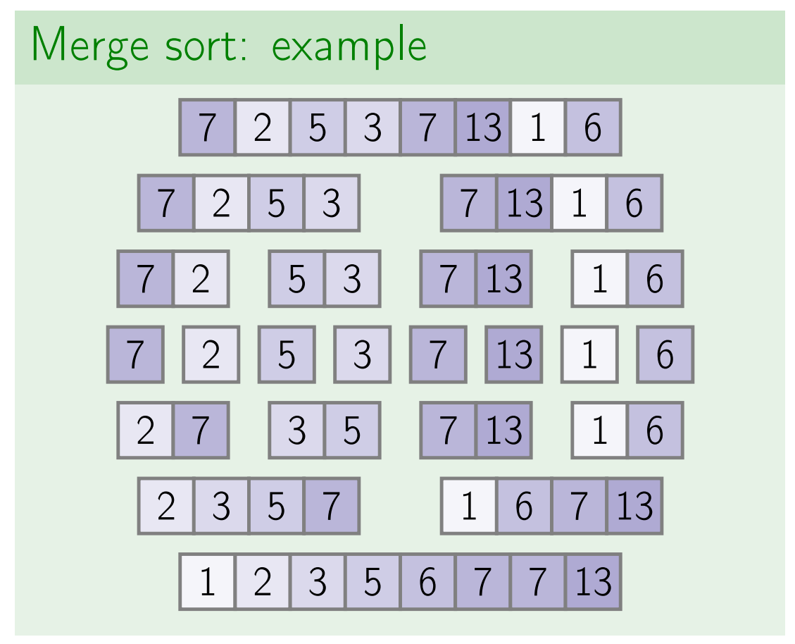
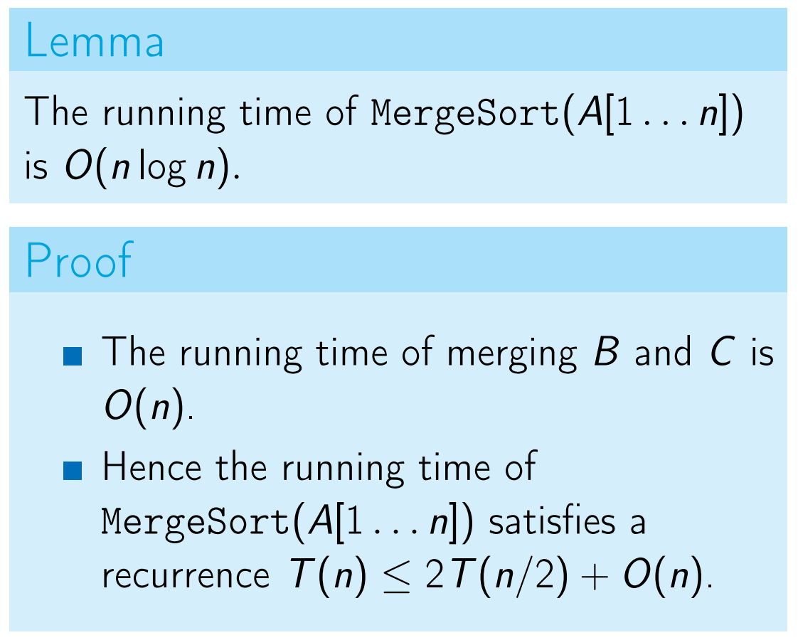
Merge Sort

Slide 16
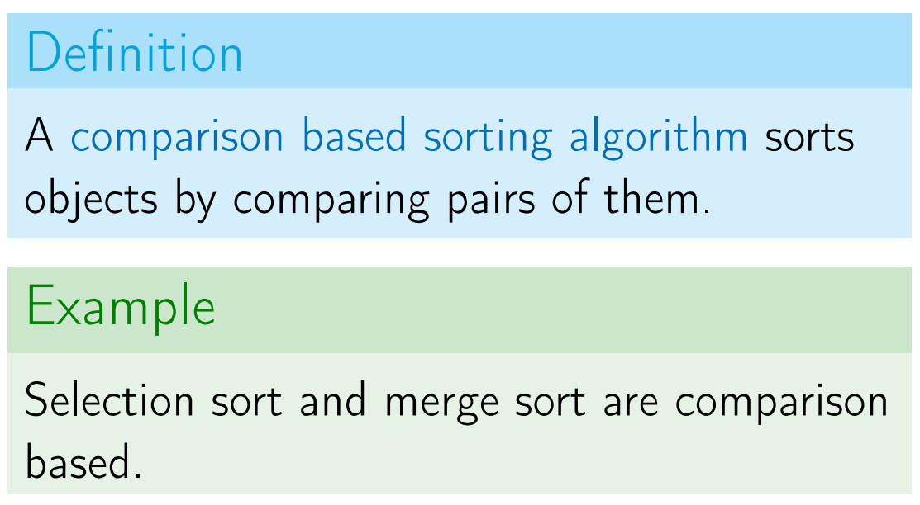
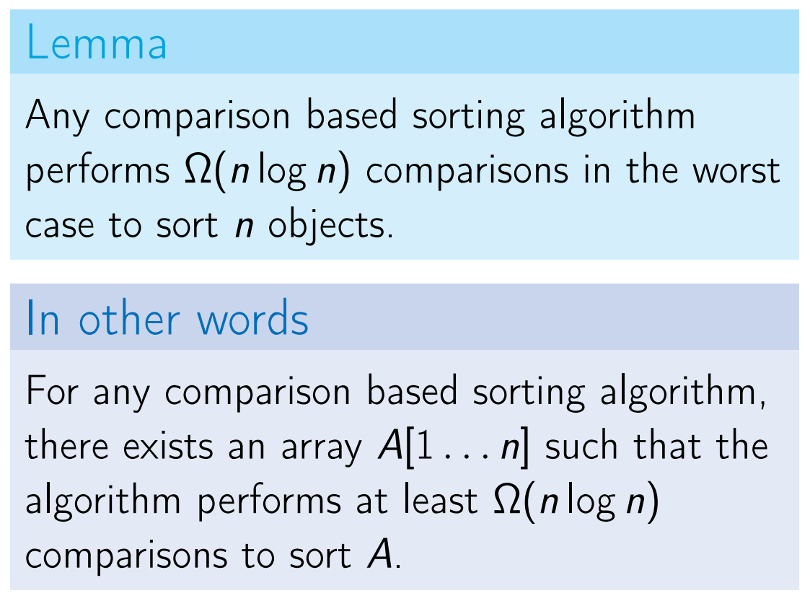
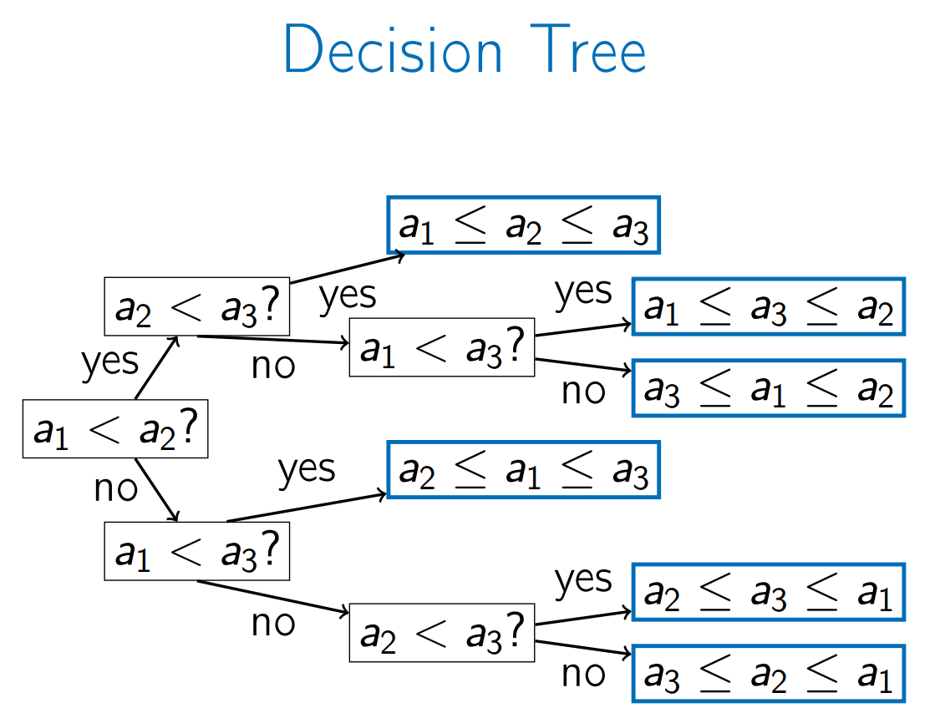
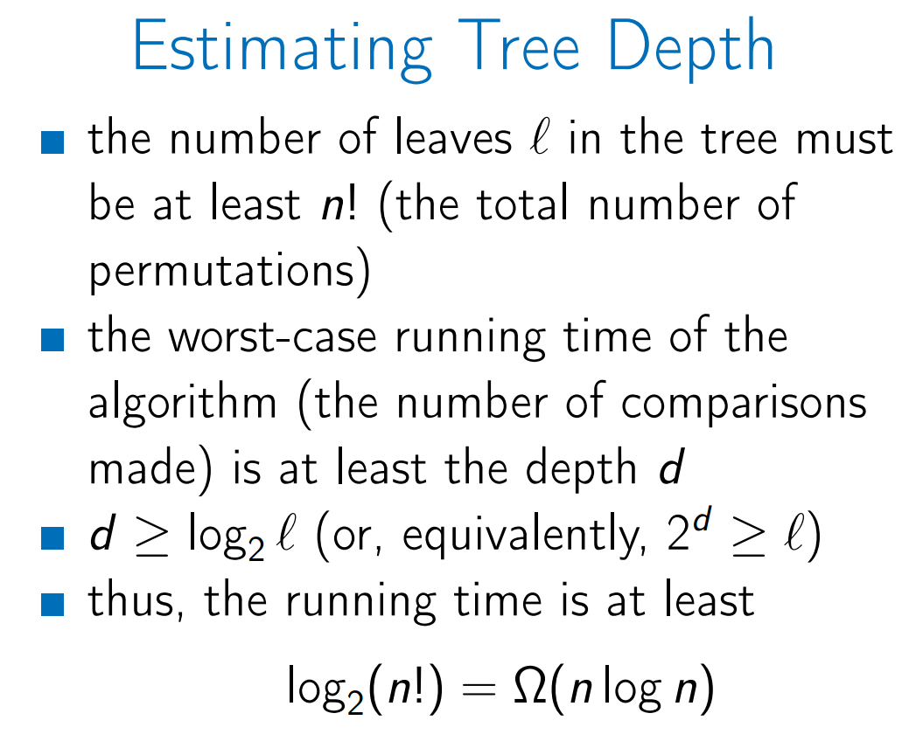
Lower Bound for Comparison Based Sorting

Slide 17
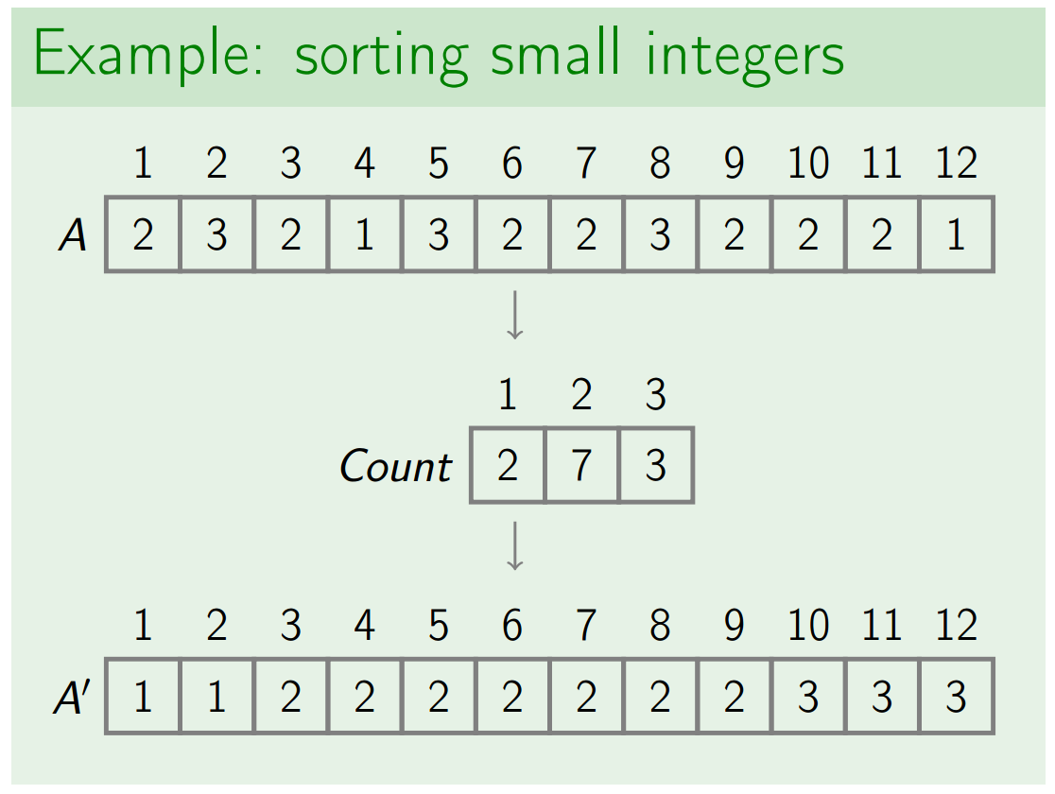
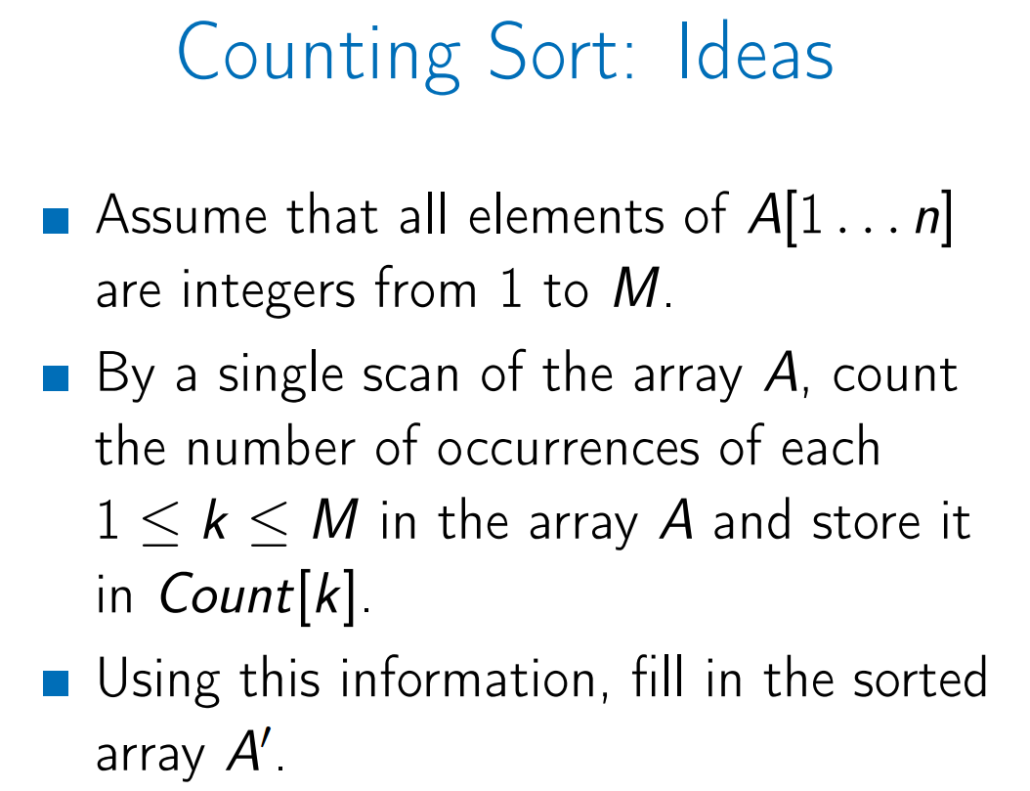
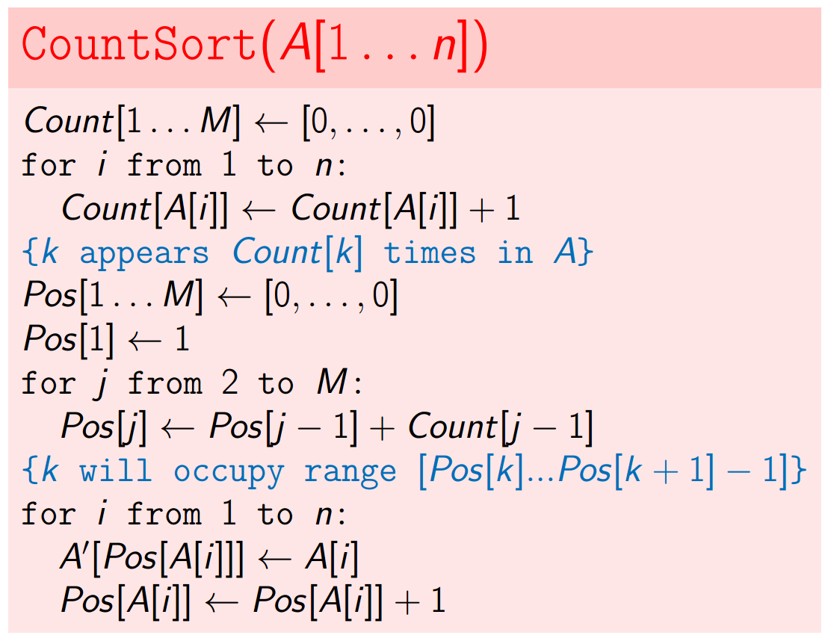
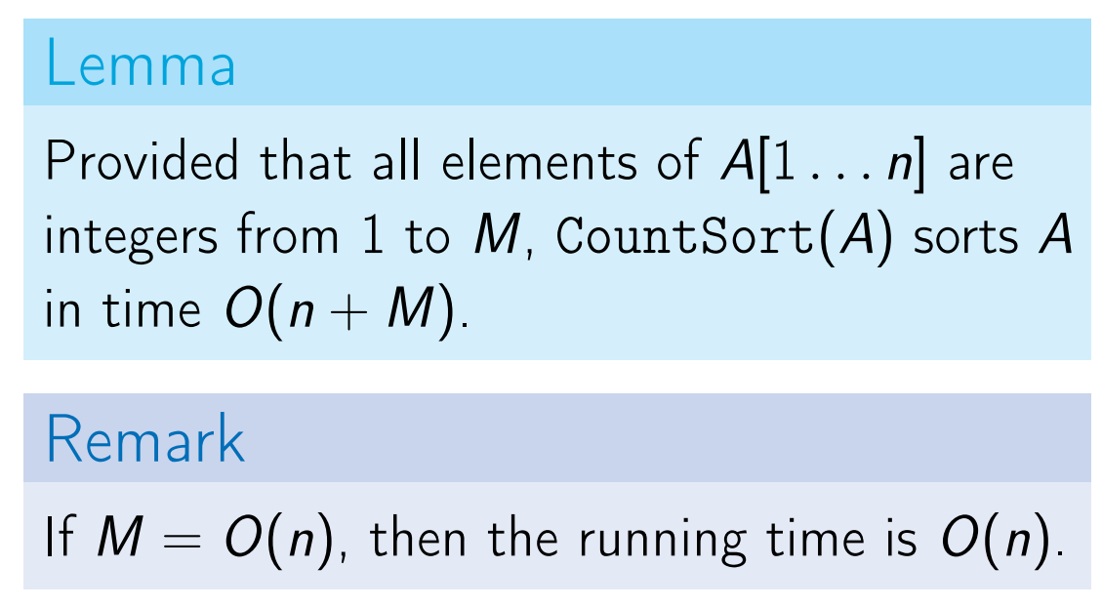
Non-Comparison Based Sorting Algo – Count Sort

Slide 18
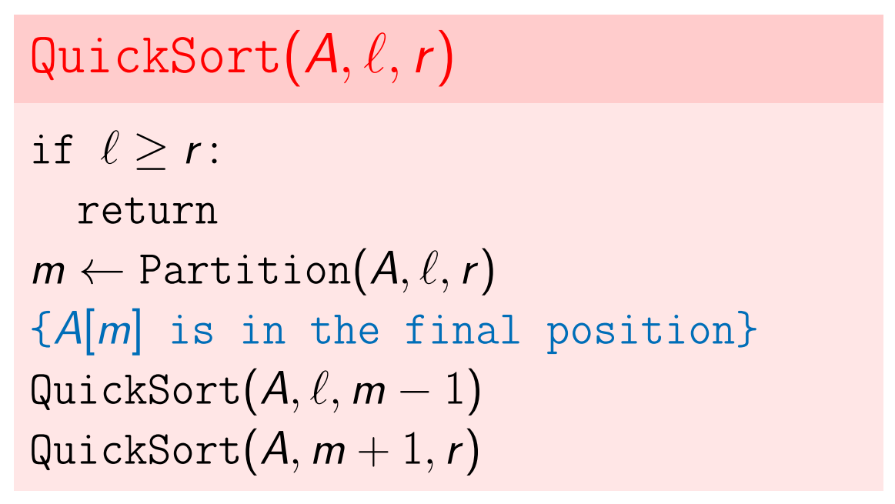
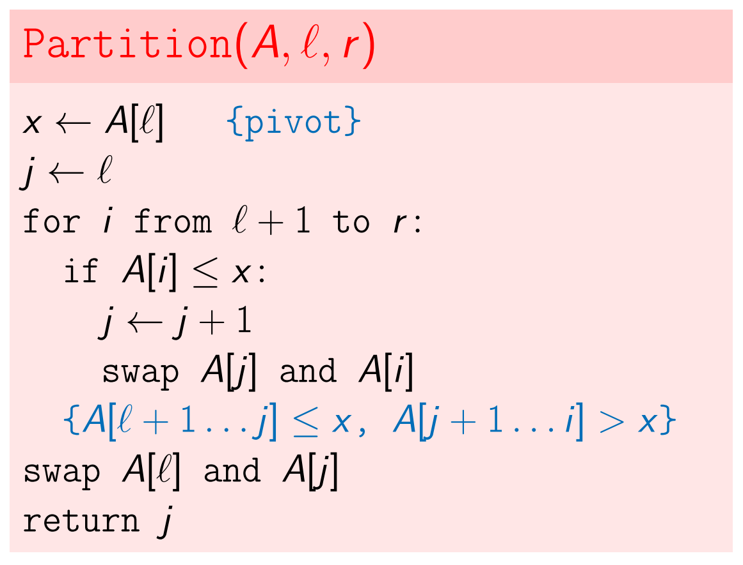
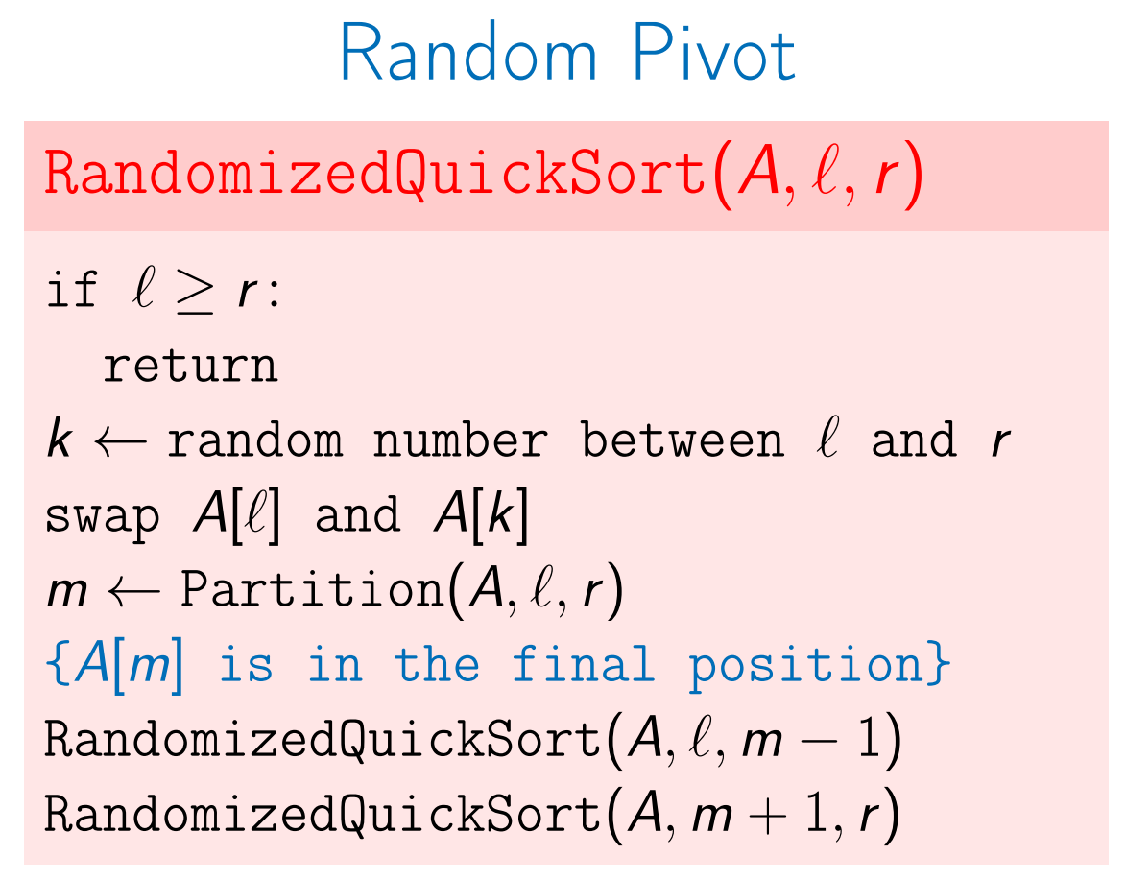
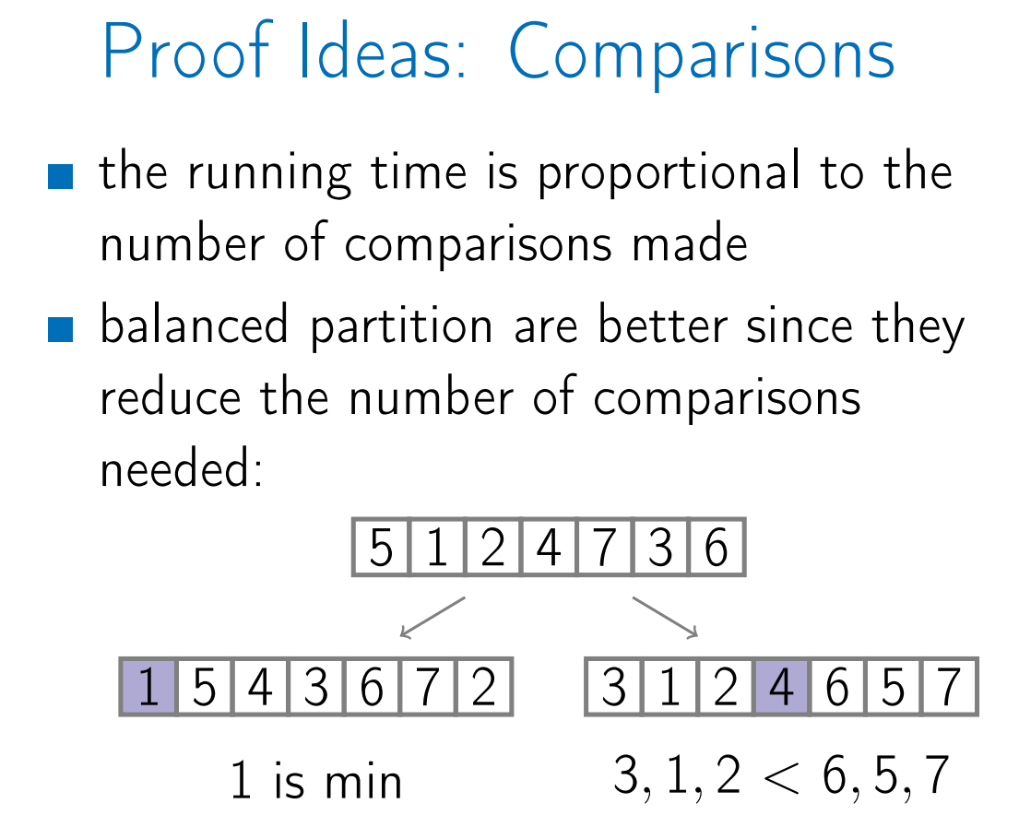
Quick Sort 2
The worst-case time complexity of a typical implementation of QuickSort is O(n2). The worst case occurs when the picked pivot is always an extreme (smallest or largest) element. This happens when input array is sorted, or reverse sorted and either first or last element is picked as pivot. Also, happens if all the elements of the given array are equal.

Slide 19
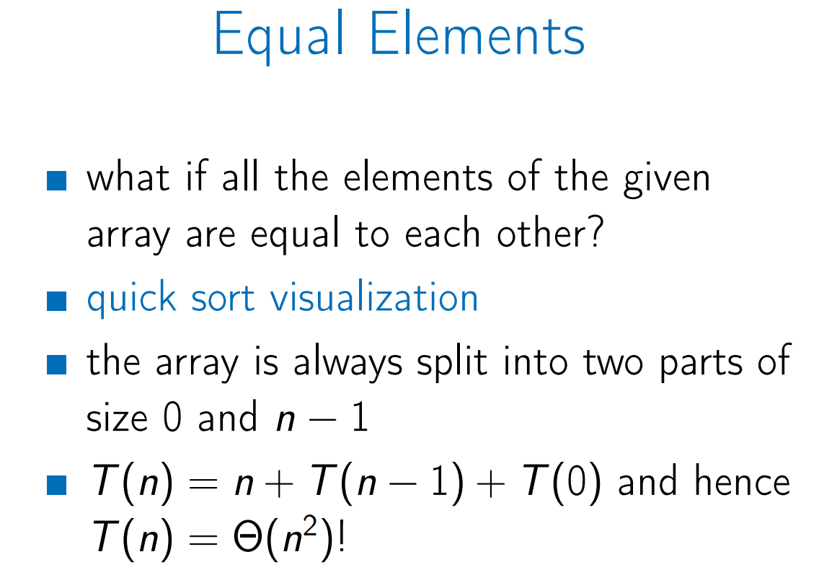



Quick Sort 3
The worst-case time complexity of a typical implementation of QuickSort is O(n2). The worst case occurs when the picked pivot is always an extreme (smallest or largest) element. This happens when input array is sorted, or reverse sorted and either first or last element is picked as pivot. Also, happens if all the elements of the given array are equal.

Slide 20




Coin Change - Dynamic Programming
As we already know, a natural greedy strategy for the change problem does not work correctly for any set of denominations. For example, if the available denominations are 1, 3, and 4, the greedy algorithm will change 6 cents using three coins (4 + 1 + 1) while it can be changed using just two coins (3 + 3).

Slide 21




Edit Distance- Dynamic Programming
Maximizing the length of a common subsequence corresponds to maximizing the score of an alignment with 𝜇 = 𝜎 = 0.
Edit Distance is the minimum number of operations (insertions, deletions, and substitutions of symbols) to transform one string into another.
Minimizing Edit Distance is maximizing alignment Score.

Slide 22




Knapsack with repetitions
Why does greedy fail for the discrete knapsack?
Taking an element of maximum value per unit of weight is not safe!

Slide 23





Knapsack without repetitions
The running time O (nW ) is not polynomial since the input size is proportional to log W , but not W .
In other words, the running time is
O(n2^log W). [pseudo-polynomial]
E.g., for
W = 71 345 970 345 617 824 751
(Twentу digits only!) the algorithm needs roughly 10^20 basic operations.

Slide 24




Placing Parentheses
Running time is O(n^2)

